Slide 1
Workshop 9
Advanced Stream Processing Pipelines
Building Real-Time Weather Data Analytics
Notes:
Welcome: Welcome to Workshop 9 where we'll explore advanced stream processing pipelines. Over our previous workshops, we've worked with data in different ways, from making it quickly available for analysis (workshop 5) to processing periodic updates in batch (workshop 7). Today, we get to physically try real-time data processing.
AWS but universal concepts: Before we start, I want to emphasise that while we'll be using AWS tools today, the concepts we'll cover are universal. Whether your organisation uses Azure, Google Cloud, or open-source solutions like Apache Kafka, the patterns and principles we'll explore will apply across all these platforms.
Streaming is like a river of data: Think of stream processing like a river system. Just as a river continuously flows, collecting water from various tributaries and delivering it to different locations, our data streaming system will continuously collect data from sources, process it, and deliver it to various destinations for analysis. Today we'll build this kind of system step by step.
Today’s scenario / use case: Weather data monitoring at precise geo locations: For our example, we'll use weather data monitoring as our example, but the patterns we develop could just as easily apply to financial transactions, IoT sensor readings, or any situation where immediate data processing adds value. I encourage you to think about your own organisation and project as we progress through the workshop. Consider how these streaming patterns might enhance your current batch processes or enable new capabilities in your data platforms.
Do no panic! EPA/IFATE does not require streaming! However, to be clear you are not required to demonstrate streaming in your project, only knowledge of it in relation to your organ
Questions? Are there any questions before we look at how this workshop aligns with your apprenticeship requirements?

Slide 2

Workshop Alignment with IFATE Pass Descriptors
Star Schemas and Data Warehousing (K15)
Building and maintaining a star schema with Type 1 SCD updates in Azure Synapse
Data Engineering Tools (K20)
Practical experience with Azure SQL, Azure Synapse, and Dedicated SQL Pools
Pipeline Deployment (K8)
End-to-end deployment of automated batch update pipeline
Data Store Monitoring (K1, S7)
Implementing audit logging and pipeline monitoring for reliable updates
Data engineer / Institute for Apprenticeships and Technical Education

Slide 3

Workshop Objectives
Learn how to work with:
Batch processing: Create automated batch processing pipelines to keep dimensional models current as source data changes (OLTP to OLAP updates)
Data staging: Implement reliable data movement using staging tables to transfer data between source and target systems safely
Monitoring: Implement audit logging tables to track successful loads and provide operational monitoring
Dimension updates: Apply Type 1 Slowly Changing Dimension (SCD) updates to overwrite old customer data with new values, maintaining only current information

Slide 4
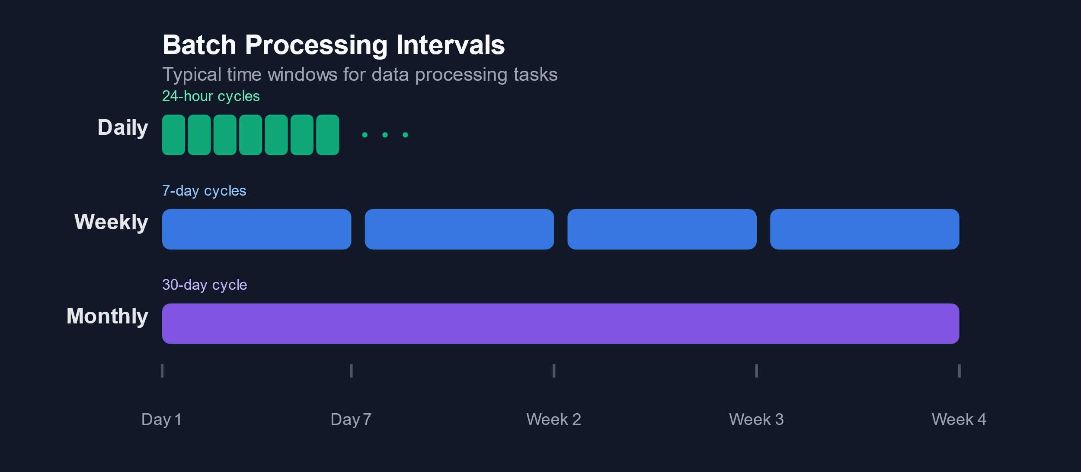
Why Batch Processing?
Common Use Cases
Daily sales reports and dashboards
Weekly performance summaries
Monthly analytics refreshes
What regular reporting or analytics tasks in your organisation currently use or might benefit from batch processing?
How frequently do these need to update?

Slide 5
Why Batch Processing?
Key Benefits
Efficient processing of large data volumes
Predictable resource usage
Simple scheduling and monitoring
Looking at these benefits, where in your organisation have you seen these work well or struggle?
For example, has scheduling regular loads ever been challenging?

Slide 6

Morning activity
Building the pipeline

Slide 7
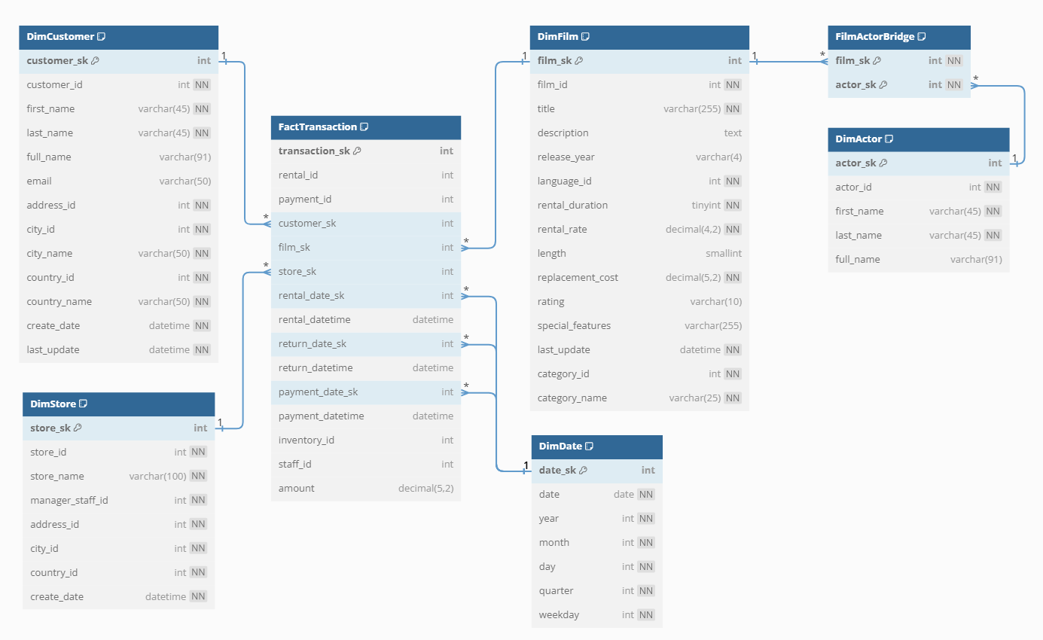
What We'll Build Today
Automated data warehouse updates using Azure Synapse
Focus on Customer dimension maintenance
Type 1 SCD implementation with audit logging
Building on Workshop 3's static star schema and Workshop 6's design work

Slide 8
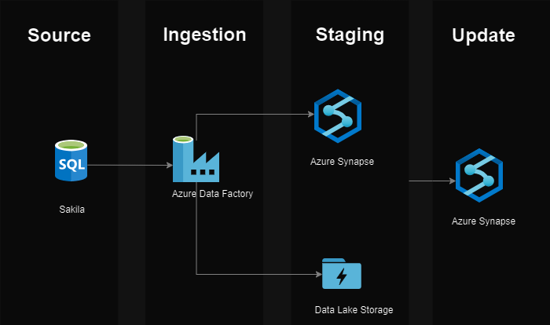
Our Architecture
Key Components
Source: Sakila OLTP database in Azure SQL (OLTP)
Ingestion: Azure Data Factory pipeline
Staging: Choice of:
Azure Synapse staging tables
Data Lake Storage
Update: Azure Synapse dimension table (OLAP)
Pipeline Operations.
Extract the latest customer data
Stage with audit columns
Process Type 1 SCD updates

Slide 9
Workshop Flow
Morning
Building the Pipeline
Environment setup
Schema and table creation
Pipeline development
Testing with simulated changes
Going Further (time permitting)
Data Lake integration
Data Flow transformations
PySpark notebook processing
Afternoon
Workshop Reflection
What went well?
Technical challenges?
Learning points and insights?
Project Application
Project data sources
Update patterns and data models
Implementation strategies

Slide 10
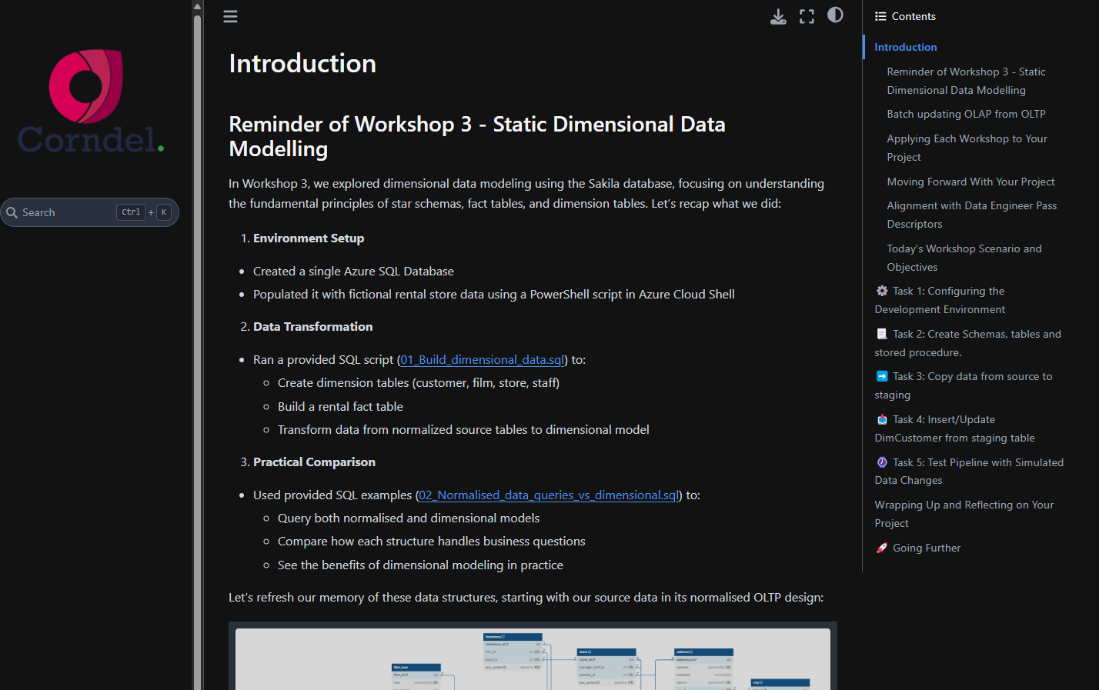
Workshop Instructions: Your Step-by-Step Guide
Key concepts and terminology
Task breakdown and dependencies
Optional "Going Further" sections
How to ask for help
We will now walk through the document structure and highlight how each section builds on the previous one to create a complete pipeline

Slide 11

Afternoon activity
Reflecting on the morning activity and how it applies to your project

Slide 12
Workshop reflection
⚙️Technical Implementation
1 ✨Which parts of the pipeline came together smoothly?
2 🚧Where did you encounter challenges?
🛣️Learning Journey
1 💡What key concepts clicked today?
2 🤔 Which concepts need more exploration?
3 🔎What debugging approaches worked best?
3 ⚖️How does this compare to any previous pipeline work?

Slide 13

Build on Your Learning from E-Learning Module 06.3
The next questions in the following two slides distil key ideas from 06.3 Batch Processing: OLTP Data Source Integration, which you may have completed prior to this workshop.
If you haven’t yet completed it, we encourage you to do so. It provides:
A foundation in batch processing concepts and their practical applications.
Key reflective prompts to align these ideas with your project and role.
Use questions in 6.3 to deepen your understanding of:
The batch processing patterns most relevant to your project.
Robust pipeline design, update patterns, and optimisation techniques.
How these align with user and business needs
These reflections aren’t just for today:
Use them as a starting point for future discussions with your PDE in 121s.
Identify areas for improvement and questions to explore further with your PDE.

Slide 14
Project Application Discussion
📊 Project data sources
1 What type(s) of data sources does your project handle? 🗄️ OLTP databases? 📄 Files? 🌐 APIs?
4 Does the origin of your data (e.g., normalised tables, JSON files) impact your pipeline design? 📝
🔄️Update patterns
1 What update pattern best fits your use case? 🔄 Full refresh 🔀 incremental updates📝 CDC?
3 What security and access patterns do you need to consider? 🔒
3 How can you track and validate changes? ✅
4 What could be your strategy for handling failed updates or reprocessing? 🚨
2 What challenges do the formats present? 🚧
3 What access methods are needed for each source type, and how are they configured securely? 🔐
2 🤔 What drives this choice (data volume, change frequency, etc)?

Slide 15
Project Application Discussion
🧩 Data Modelling & Requirements
1 Have you defined clear user and business requirements yet? 📝
2 Does your chosen data model support these effectively? 🎯
🚀Implementation and Optimisation
1 What tools and frameworks are you using/considering? ☁️ Cloud-native services? 🖥️ Local or on-prem tools? 🎵 Orchestration tools?
3 How do you handle historical data needs? Is Type 1 SCD sufficient or do you need Type 2? 🔁
3 How are you optimising performance? 📊 Partitioning strategy? 🏷️ Indexing approach? 📂 Compression techniques? 🔍 Query optimisation? 🖥️ Hardware/resource allocation? ⚙️ Parallel processing?
4 What monitoring and logging is appropriate? 📈
4 How do you validate data quality? ✅
2 🤔 Why are these the right choices for your needs?
5 Are your pipelines idempotent, and how do you handle retries?

